Slide 1
CLOUD COMPUTING
Elastic Computing & the Cloud Landscape
Virtualization, service models (IaaS / PaaS / SaaS), and how organizations choose between private, public, hybrid, and multi-cloud strategies.
Lecture Chapters 2 & 3

Slide 2
AGENDA
What We'll Cover
01
Elastic Computing
Multi-tenancy and the core idea of leasing servers on demand
02
Virtualization
How virtualized servers give providers speed, flexibility, and isolation
03
Service Models
Infrastructure, Platform, and Software as a Service — and Desktop as a Service
04
Cloud Types
Private, public, hybrid, and multi-cloud strategies
05
Hyperscalers
The largest cloud providers and market growth

Slide 3
Why and when cloud?
Startup leases cloud facilities for its web site – Pay as required
Smart phone and Smart Home systems
An enterprise leases facilities and software for business functions
  such as payroll, accounting, and billing.
Browser based editing of shared document.
Medical device that periodically uploads readings for analysis;
  Alert systems
A seasonal company leases computing facilities during 5 peak months each year;
  No payment for facilities at other times.
Log into a social media site and uploads photos.

Slide 4
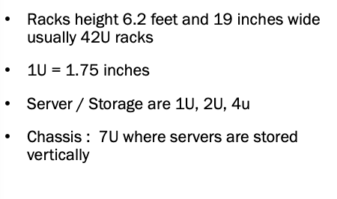
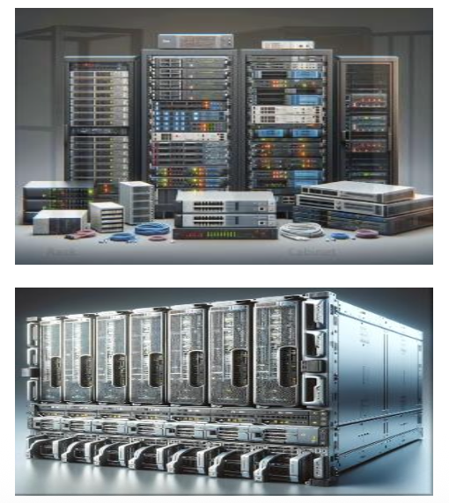
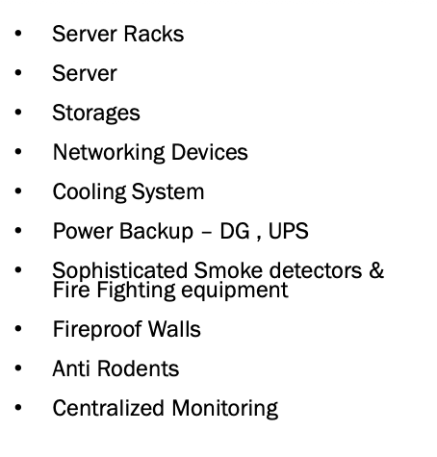
Data Center – What makes it?

Slide 5
A data center is a
dedicated physical facility
used by organizations to
house their critical
applications, data, and IT
infrastructure.

Slide 6
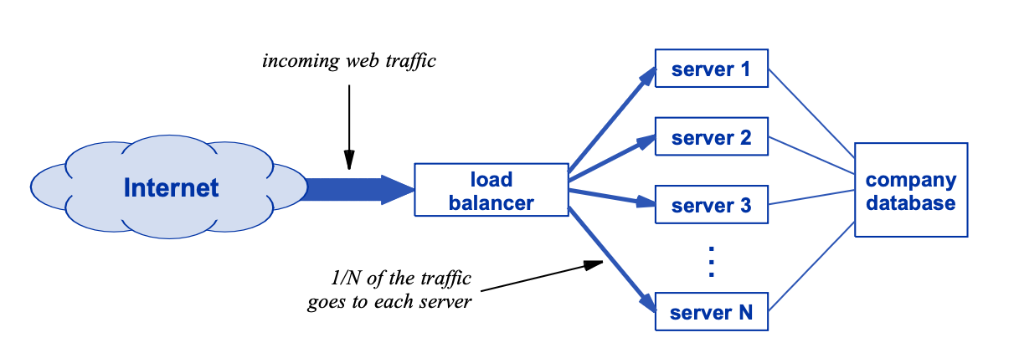
DISCUSSION QUESTION
“
Why call it Cloud Computing?
how can a web site scale to accommodate thousands of users?
Elastic Computing
3

Slide 7
DISCUSSION QUESTION
“
Saying a data center is “in the cloud” is technically inaccurate
Servers in a data center are not part of the Internet itself.
Instead → Merely computers attach to the Internet
Depicted outside the cloud, with network connections leading to the cloud.
Why did the industry start using the terms cloud computing and say that the computing is in the cloud if it is not?
Early data centers needed fast links to Internet backbones
Placing them near peering points (where backbones connect) cut costs
Some sat in the same building/floor as peering equipment
This closeness led engineers to say the center was "in the cloud" — term stuck
Phrase is technically inaccurate, but that's its origin
Elastic Computing
3

Slide 8
DISCUSSION QUESTION
“
What actually changes when a data center starts serving many different customer organizations instead of just one?
Elastic Computing
3

Slide 9
FOUNDATIONS
Multi-Tenant Clouds
A data center that serves customers from many organizations at once.
Consolidating servers into one data center already saves money — quantity discounts on hardware and less IT staff overhead.
Cloud providers extend that advantage to a much larger scale: one facility handles computing for many customers at once, not just one organization.
SHARED DATA CENTER
Org A
Org B
Org C
Org D
Multi-tenancy also applies inside a single organization — e.g., a finance department keeping its data fully separate from the rest of the company.
Elastic Computing
4

Slide 10
DISCUSSION QUESTION
“
How can a company avoid paying for servers it isn't using, without running out of capacity during a busy period?
This is the problem elastic computing was built to solve.
Elastic Computing
5

Slide 11
FOUNDATIONS
The Concept of Elastic Computing
Lease only what you need — and change it at any time.
peak demand
Pay for what you use
Customers lease a few servers or many, and pay only for that number.
Change allocation dynamically
Add servers during peak times, decrease them when demand drops.
Early approach: fixed sizes
Rack, half-rack, or quarter-rack allocations — flexible, but still tied to physical resources.
SERVERS LEASED OVER TIME
Elastic Computing
6

Slide 12
DISCUSSION QUESTION
“
If a data center never reboots or reconfigures a physical machine, how can it launch a brand-new server in milliseconds?
The answer lies in virtualization.
Virtualization
7

Slide 13
VIRTUALIZATION
Virtualized Servers for Rapid Change
Providers don't allocate physical machines — they run software that creates virtualized servers.
↻
▣
⬢
Rapid Creation & Removal
Physical Sharing
Logical Isolation
Managed entirely by software — a server can be created or removed at any time, with no reboot of physical machines.
A virtualized server is a software artifact. Many virtualized servers can run on one physical server concurrently.
Each virtualized server is fully isolated — no other tenant can observe or affect its data or computations.
Virtualization
8

Slide 14
DISCUSSION QUESTION
“
Virtualization clearly saves the provider money — but what does it actually do for the customer?
There are real benefits on both sides of the relationship.
Virtualization
9

Slide 15
VIRTUALIZATION
Who Benefits, and How
☁
For the Provider
☺
For the Customer
Creation takes milliseconds, not minutes — scales to thousands of virtualized servers
A virtualized server acts just like a physical one, with its own Internet address
No need to reconfigure or reboot physical servers
Ease of creating and deploying new services with provider/vendor tooling
Isolation lets tenants mix freely on the same physical server, with zero data leakage risk
Rapid scaling — add copies of an app as requests arrive over the Internet
Load balancing: place new servers on lightly-loaded machines to avoid overload while others sit idle
Safe, isolated testing of new software before it reaches production
Virtualization
10

Slide 16
DISCUSSION QUESTION
“
If you just want to run a website, do you really need to buy and manage your own servers?
This is exactly the choice cloud service models let you make.
Service Models
11

Slide 17
SERVICE MODELS
Three Ways to Buy the Cloud
As you move up the stack, the provider manages more — and you manage less.
MORE YOU
MANAGE
SaaS
Software as a Service
Subscribe to finished applications — e.g., Office 365. You manage nothing but your account.
PaaS
Platform as a Service
Build and deploy software without managing the underlying infrastructure.
IaaS
Infrastructure as a Service
Servers, storage, and networking. You choose the OS and applications.
+ DaaS (Desktop as a Service): a full remote desktop delivered from the cloud
MORE PROVIDER
MANAGES
Service Models
12

Slide 18
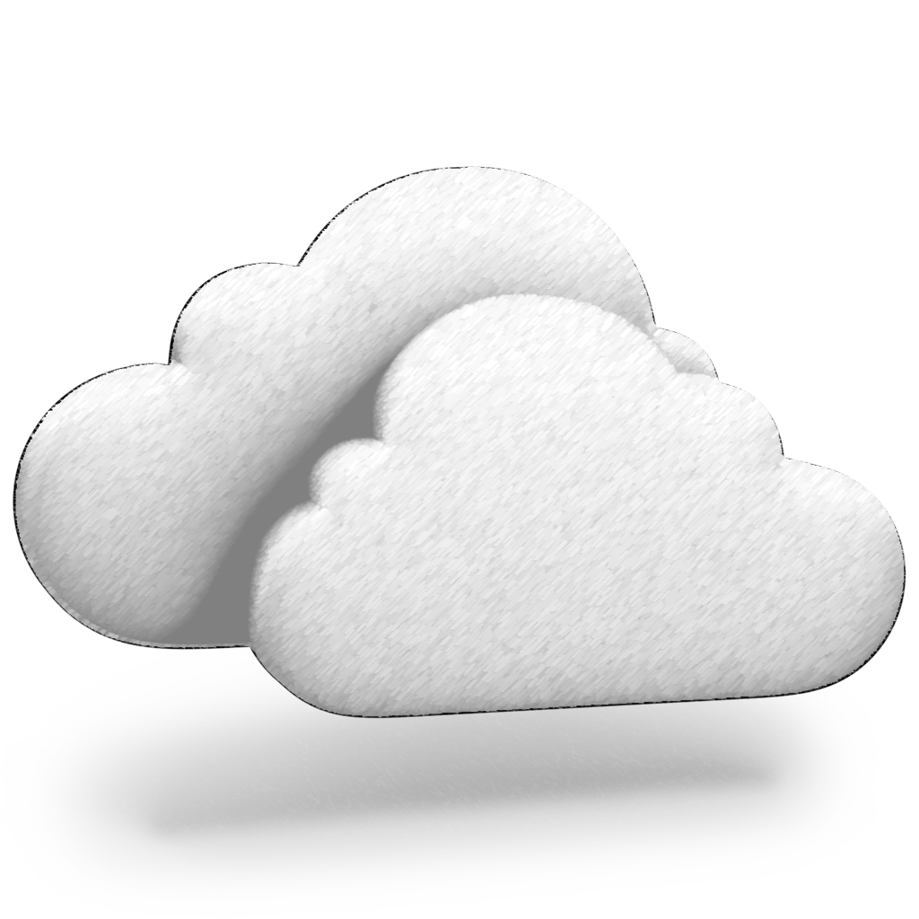
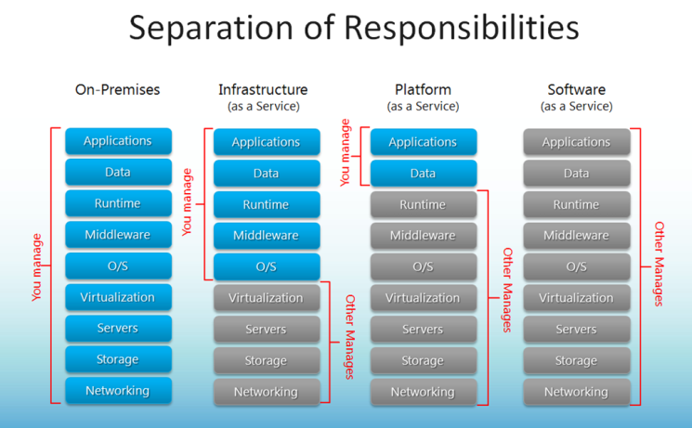
Cloud Delivery Models
BUILDING BLOCKS
IaaS – Infrastructure as a Service
PaaS – Platform as a Service
SaaS – Software as a Service
Combining Cloud Delivery Models
Notes:
Is website in old days a SaaS?

Slide 19
DISCUSSION QUESTION
“
What's the real difference between renting raw infrastructure and renting a platform to build on?
It comes down to how much of the stack the provider manages for you.
Service Models
13

Slide 20
SERVICE MODELS
IaaS & PaaS
IaaS
PaaS
Infrastructure as a Service
Platform as a Service
Physical building, power, cooling, servers, networking, and basic block storage.
Build and deploy software without managing the underlying facility.
Load balancers, backup, network security
Compilers, middleware, runtimes (Java, .NET)
Boots physical & virtualized servers
Hosts the customer's applications
Customer picks OS, apps, firewall rules
Formerly called “Framework as a Service”
Most advanced offerings auto-scale
Some PaaS tools run on-prem, behind your firewall
Service Models
14

Slide 21
DISCUSSION QUESTION
“
Why does editing a file on your laptop just... show up correctly when you open it on your phone?
That guarantee is baked into how SaaS is built.
Service Models
15

Slide 22
SERVICE MODELS
SaaS: Three Guarantees to Customers
A subscription model: apps and files live in the cloud, not on the user's device.
🌐
Universal Access
⇄
Guaranteed Sync
⚡
High Availability
Reach the same apps and files from any device, any time — via app or browser login.
Only one copy of each file exists. Changes on one device appear everywhere — no manual re-sync.
Backup power and off-site data backups mean service survives outages, even disasters.
🖥
A Special Case: Desktop as a Service (DaaS)
Instead of one app, DaaS delivers an entire remote desktop — OS, apps, and files all run in the cloud. All of a user's computing gets universal access, sync, and high availability, not just a single application.
Service Models
16

Slide 23
DISCUSSION QUESTION
“
If public cloud is usually cheaper, why would any organization still build and run its own data center?
Both models have real trade-offs — let's compare them directly.
Cloud Types
17

Slide 24
CLOUD TYPES
Private Cloud vs. Public Cloud
🔒
Private Cloud
🌍
Public Cloud
An internal cloud, owned and operated by one organization, for its own use.
A commercial service, operated by a provider, used by many customer organizations.
Applying elastic principles internally avoids underutilized AND oversubscribed servers by spreading computing across all physical machines — even when different departments' demand varies.
Customers choose a service tier — large enterprises often want IaaS with add-on security & backup; builders want PaaS; smaller customers may just subscribe to a single SaaS offering.
Cloud Types
18

Slide 25
DISCUSSION QUESTION
“
Beyond lower cost, what does a public cloud provider offer that's genuinely hard to build in-house?
Think about scale, staff, and services a single company can't easily replicate.
Cloud Types
19

Slide 26
CLOUD TYPES
Why Choose Public Cloud?
$
★
⚙
Economic
Expertise
Advanced Services
Economy of scale: bigger discounts on hardware, shared whitebox switches run by SDN, and shared IT staff — cited savings up to ~75% vs. private deployment.
Access to specialized staff across a far wider range of topics than any single in-house IT team, including AI/ML.
AIops automates operations and monitors for anomalies; platforms let engineers deploy apps without learning the infrastructure underneath.
Trade-off: providers court lock-in — free convenience services and migration tools that make it costly to ever switch providers.
Cloud Types
20

Slide 27
DISCUSSION QUESTION
“
If public cloud offers more expertise and a lower price, what could possibly justify staying private?
Cost isn't the only thing that matters to an organization.
Cloud Types
21

Slide 28
CLOUD TYPES
Why Choose Private Cloud?
Public cloud isn't the answer for everyone — private cloud trades some savings for control.
1
Control & Visibility
Full root-cause access to your own switches and servers; helps satisfy regulatory requirements on data placement and handling.
2
Reduced Latency
On-premises facilities cut the delay between employees and the data center, especially useful for geographically distant public cloud sites.
3
Rate-Hike Insurance
No provider lock-in risk. As adoption of a provider's services deepens, switching costs rise and the provider can raise prices.
Cloud Types
22

Slide 29
DISCUSSION QUESTION
“
Is choosing a cloud strategy really an all-or-nothing decision between private and public?
Most large organizations land somewhere in between.
Cloud Types
23

Slide 30
CLOUD TYPES
Hybrid & Multi-Cloud Strategies
Hybrid Cloud
Multi-Cloud
A mix: some computing stays on a private cloud, the rest runs on a public provider.
Using more than one public cloud provider to avoid dependence on any single one.
Control when needed
Why do it:
Keep regulated / classified data on the private side; push the rest to public cloud to cut cost.
Avoids lock-in risk. Large orgs may split business units across providers.
Trade-offs:
Computation overflow
Migrating between providers is hard; service parity varies; may require custom software to translate or combine outputs across providers.
Handle peak-season demand by sending overflow work to the public cloud instead of buying idle capacity.
Cloud Types
24

Slide 31
DISCUSSION QUESTION
“
How few companies actually run most of the world's public cloud infrastructure?
The market is more concentrated than most people expect.
Market Landscape
25

Slide 32
MARKET LANDSCAPE
Hyperscalers
Companies that own and operate the largest cloud computing facilities.
AWS
Azure
GCP
Amazon Web Services
Microsoft Azure Cloud
Google Cloud Platform
Launched 2006
Launched 2010
Google's cloud offering
$11B
$32.2B
$25.7B
spent per year on new servers by 2018 (Google, Amazon, Microsoft, Facebook, Alibaba combined)
Microsoft cloud revenue by 2018 — 29% of total company revenue
Amazon AWS revenue by 2018 — 11% of total company revenue
Market Landscape
26

Slide 33
SUMMARY
Key Takeaways
1
Elastic computing lets customers lease exactly the capacity they need, and change it at any time.
2
Virtualization — rapid creation, physical sharing, and logical isolation — is what makes elasticity possible.
3
IaaS, PaaS, and SaaS trade customer control for provider-managed convenience, with DaaS as a special SaaS case.
4
Private, public, hybrid, and multi-cloud each balance cost, control, and lock-in risk differently.
5
A small number of hyperscalers — AWS, Azure, GCP — dominate the public cloud market.
Cloud Computing Lecture
27

